Slide 1

GitHub Analyzer
that fetches and analyzes GitHub user profiles using REST API and JSON parsing.
What the Project Does:
✔ Fetch GitHub user profile
✔ Fetch list of repositories
✔ Parse JSON responses
✔ Analyse languages and stars
✔ Identify top repo
✔ Log API calls + errors
Om anand
0187cs231149
Github - https://github.com/Om-anand-0/Python_0187CS231149

Slide 2
Features
1 .REST API Integration
2 . JSON Parsing
3 .OOP Structure
4 .Decorator-Based Logging
5 .Error Handling
6 .Language Statistics
7 .Top Repository Finder

Slide 3
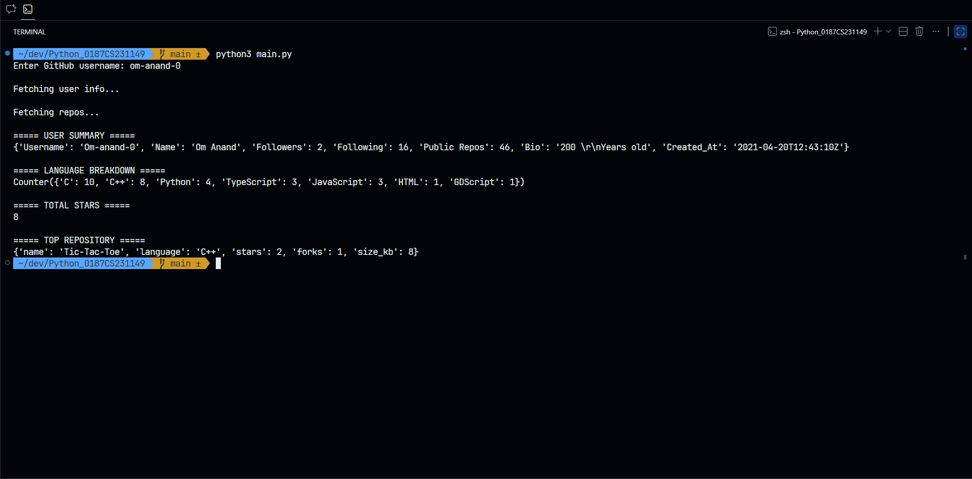
Output

